Slide 1

About Me? I am Precious Kolawole
Machine Learning Engineer at Lendsqr
Technical Writer.
Interest lies in the Intersection of Artificial Intelligence and Healthcare

Slide 2
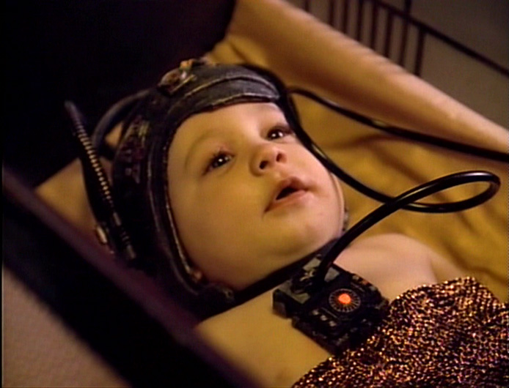
Explain Machine Learning as to a Kid

Slide 3
WTF is Machine Learning anyway?
It is a form of artificial intelligence that observes patterns
learns from these patterns
and uses what it learns to make predictions.

Slide 4
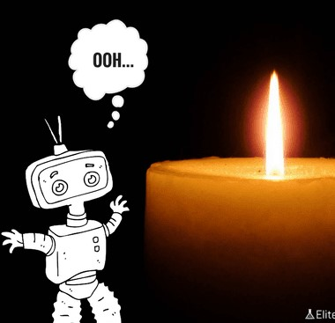
A simple analogy...

Slide 5
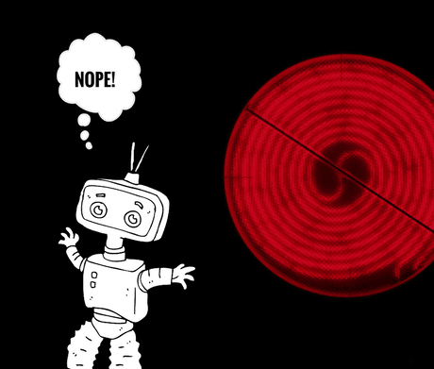
Two Days Later…

Slide 6
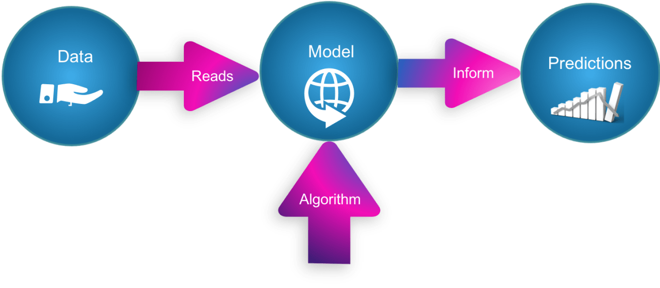
Machine Learning comes in for making decisions that are almost impossible to consistently make correctly without the help of cold, hard data, and/or deep domain expertise

Slide 7
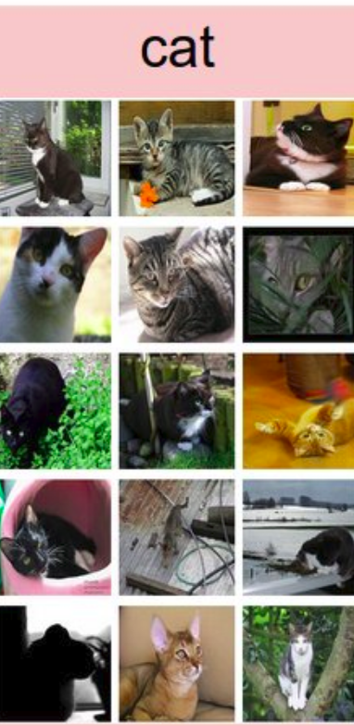
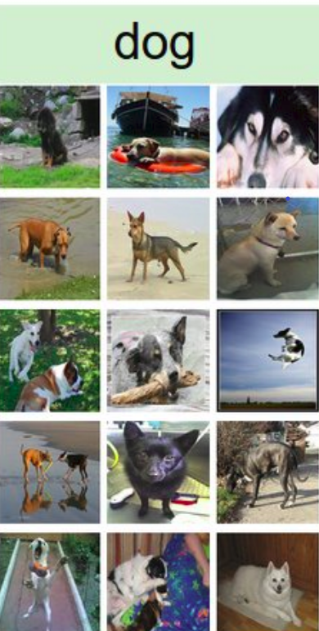
1000 cat images + 1000 dog images = 2000 total images
Label= TRUE
Label= FALSE

Slide 8
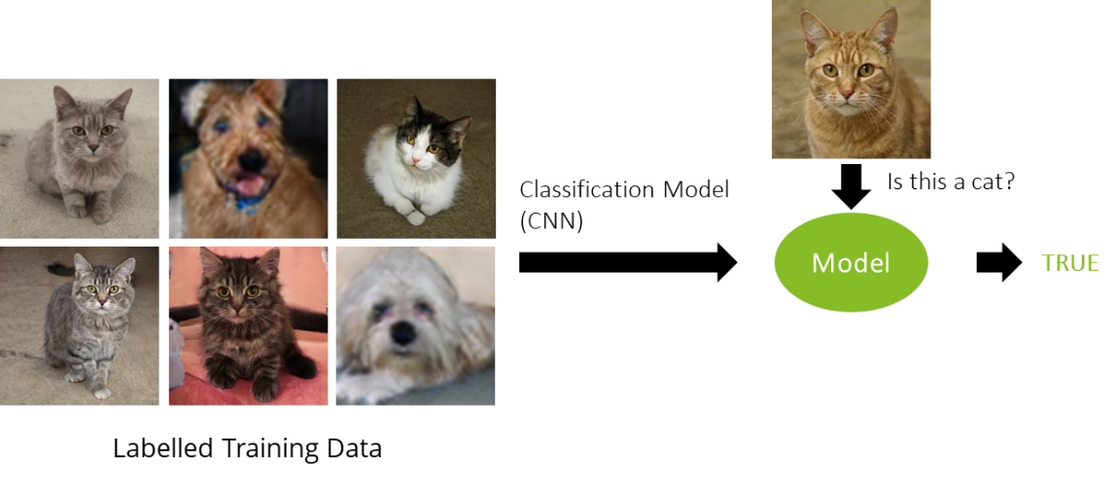
Y= f(x) --- Mapping

Slide 9
Reach me on:
Twitter
@precillieo
LinkedIn
Kolawole Precious
Email
kolawoleprecious99@gmail.com

